Slide 1
Creative Computer Engineering Design
Group 4 SMTM
Maze Runner
Introduce
Key Functions
Implementation Issues
Solutions
Play
Q & A

Slide 2
Introduce
Introduce our Product
Maze Runner
SMTM

Slide 3
Introduce
What is it?
SMTM
It’s Maze Search Machine

Slide 4
Key Functions
Functions
Scan the maze on paper using the light sensor.
Maze Scanning
Interpret the scanned value using the function defined in NXT to determine the appearance of maze
Maze Decoding
Draw on escape route by moving it from top to bottom based on the detox value.
Moving

Slide 5
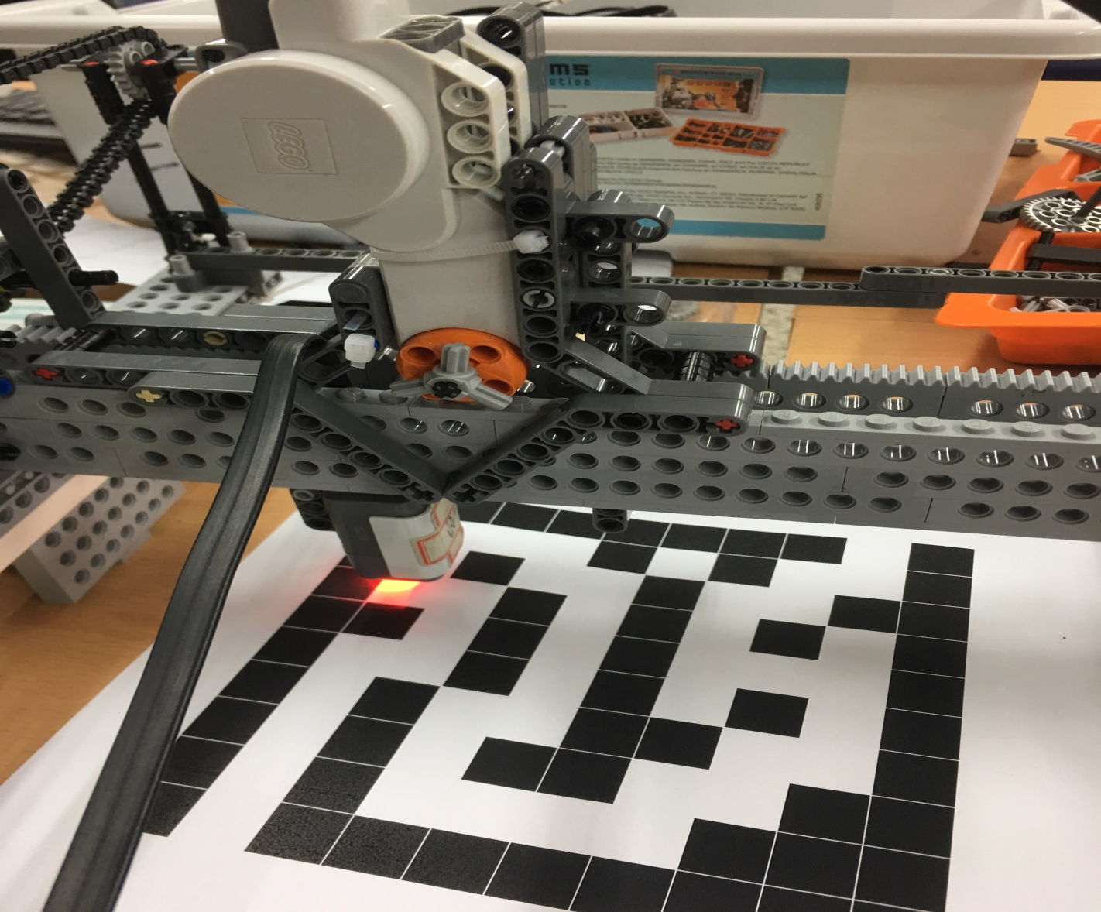
Key Functions
- Maze Scanning
How are we going to scanning the paper?!
SMTM
We use Light sensor and detect the color of the block.

Slide 6
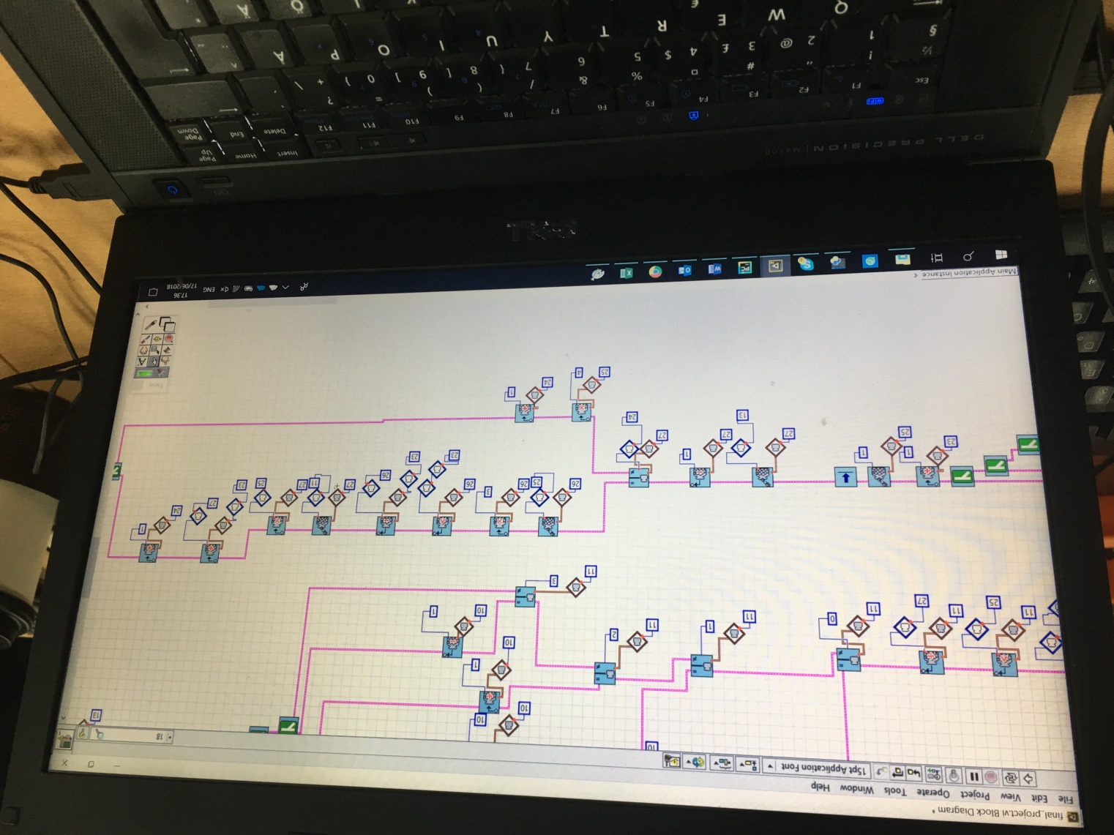
Key Functions
- Maze Decoding
How are we going to interpret the scanned value?!
SMTM
Scanning, Saving value, Interpreting, Moving with Robolab.

Slide 7
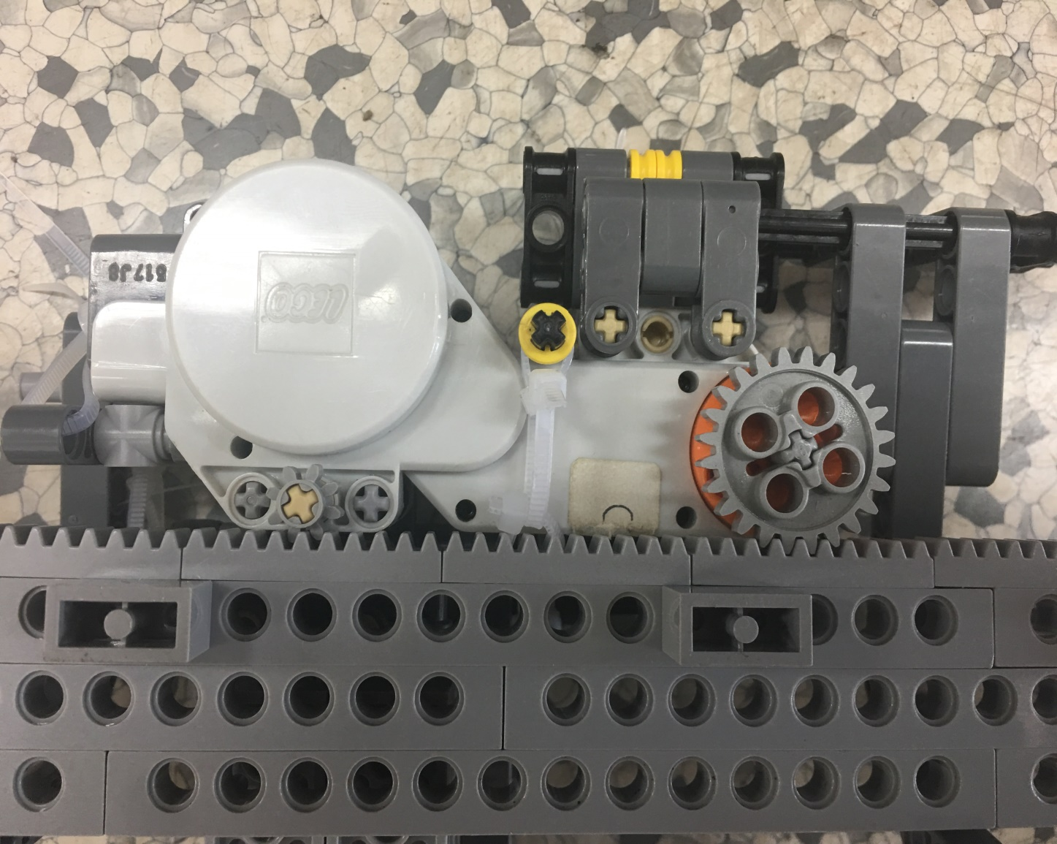
Key Functions
- Moving
How are we going to move through the x, y axes?!
we find the answer is Gear wheel.
SMTM
And it moves very stable and better performance

Slide 8
Implementation Issues
- Most concerned about in implementing
Hardware
Software
How to make X,Y axes in LEGO and MINDSTORM block?
How can we make a code in the maze to find and scan the escape route?

Slide 9
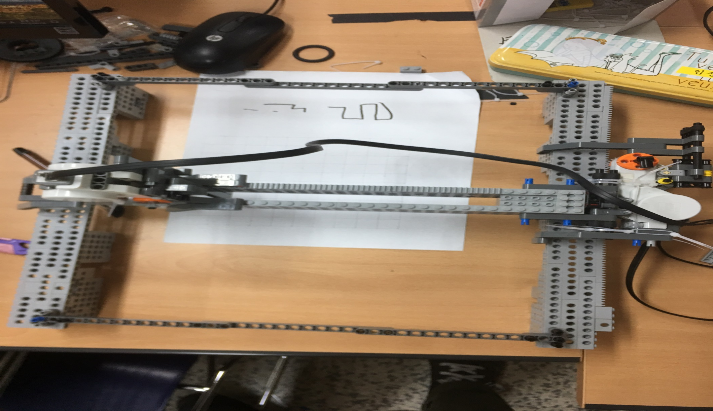
Solutions
- Hardware
First, We organized the x and y coordinates
But the problem has come.
SMTM
Y Block
X Block
It moves vertically
It moves horizontally

Slide 10
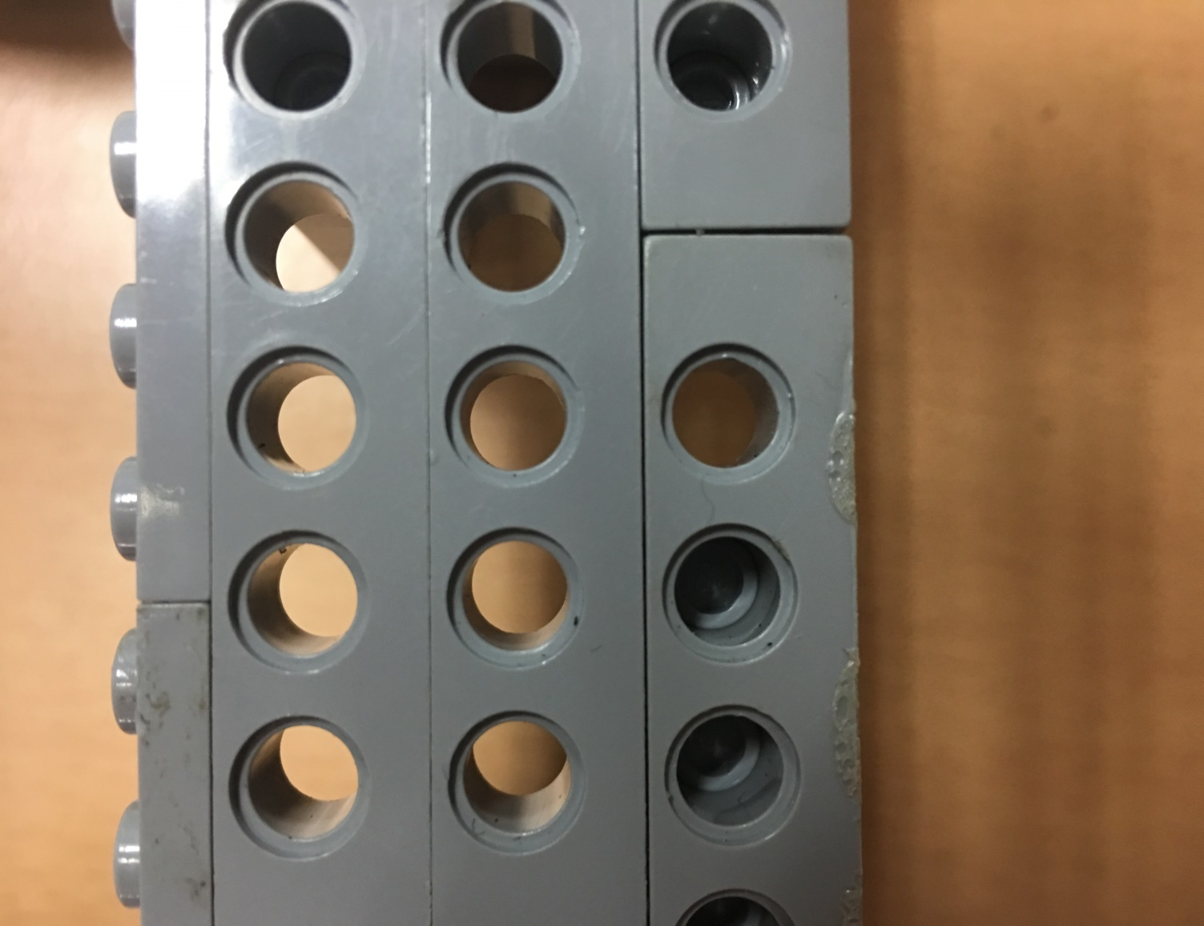
Solutions
- Hardware
The Problem was..
SMTM
The separation between the blocks and the convex part on the block made the gears unstable.

Slide 11
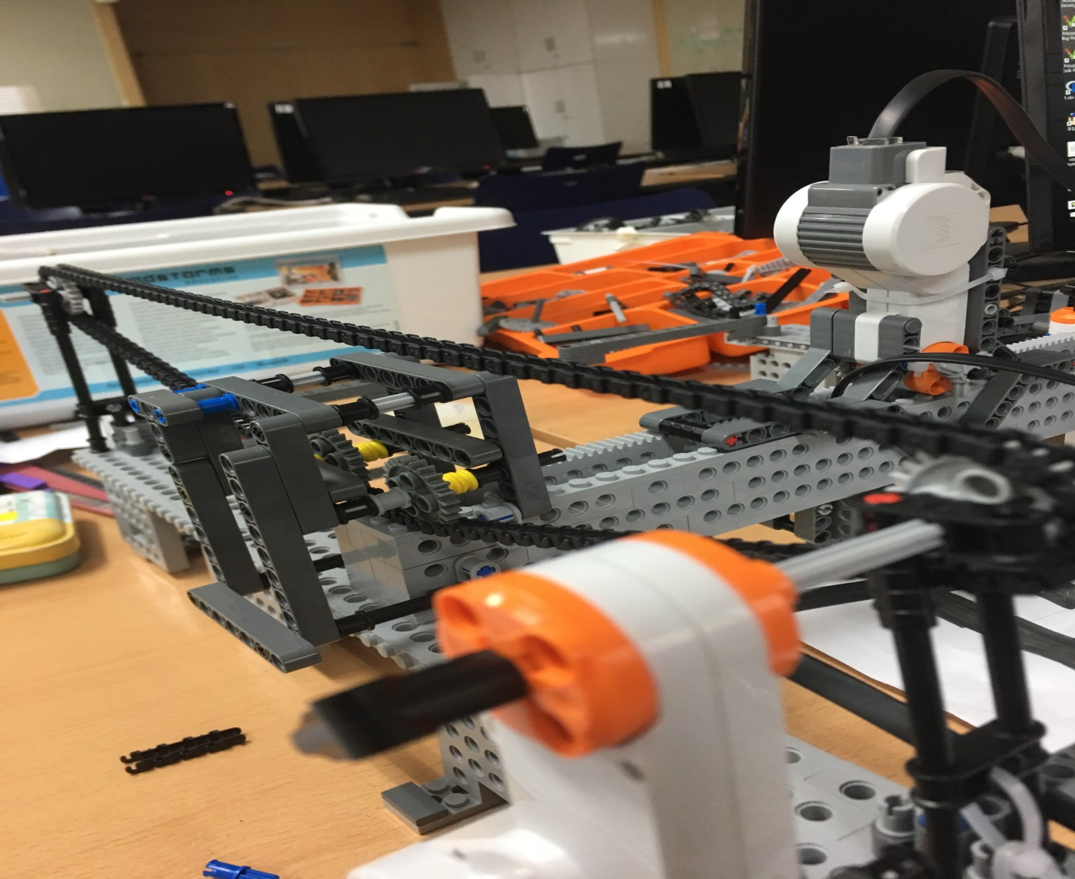
Solutions
- Hardware
The Solution was ?!
SMTM
Adding another
y-axis motor could make it move
stably

Slide 12

Solutions
- Software
How we represent the maze?
wall
SMTM
However, the maximum number of containers is limited to 20.
route
We scan the all value one by one and use container function in RoboLab

Slide 13
Solutions
- Software
The Solution was ?!
SMTM
Add all the black color in the row to the container by binary digits.
By returning the converted number back to the decimal number, it can then be used as a small container.

Slide 14
Solutions
- Software
Algorithm Example
Container has value=
1+0+4+8+16+32+64+128+256+512 = 1021
SMTM
And decoding time it Determine the mystery shape by rotating the converted decimal value back into binary.

Slide 15
Play
- Demo
SMTM

Slide 16

Q&A
ASK ME!
SMTM

Slide 17
Thank You
It’s Group 4
S M T M

